Slide 1
Observing users
Chapter 12

Slide 2
Observation
Why? Get information on..
  Context, technology, interaction
Where?
  Controlled environments
  In the field (where the product is used)
Observer:
  outsider
  participant
  ethnographers

Slide 3
Frameworks to guide observation
- The person. Who?
- The place. Where?
- The thing. What?
The Goetz and LeCompte (1984) framework:
- Who is present?
- What is their role?
- What is happening?
- When does the activity occur?
- Where is it happening?
- Why is it happening?
- How is the activity organized?
Checklist can also help (p. 369).

Slide 4
Data collection
Notes:
  not technical, writing speed may be a factor, hard to observe and write at the same time, laptop is faster but intrusive and cumbersome, two people work better than one.
Still camera:
  images are easily collected, allows evaluators to be mobile.

Slide 5
Data collection cont.
Audio:
  less intrusive than video, allows evaluators to be mobile, inexpensive, lack of visual records, hard to transcribe data.
Video:
  both visual and audio data, can be intrusive, can be inexpensive with small cameras, can allow evaluators to be mobile, attention is focused on what is seen through the lens, analysis can be time consuming.

Slide 6
Data collection cont.
Interaction logging (transcripts & replay):
  logs everything you do in the system, easy to generate detailed analysis, transparent to the user, facial expression etc. is not logged.
  CS111 example using GREWP tool.
Techniques may be used individually or combined => requires coordination.

Slide 7
Data analysis
Qualitative data - interpreted & used to tell the ‘story’ about what was observed.
Qualitative data - categorized using techniques such as content analysis.
Quantitative data - collected from interaction & video logs. Presented as values, tables, charts, graphs and treated statistically.

Slide 8
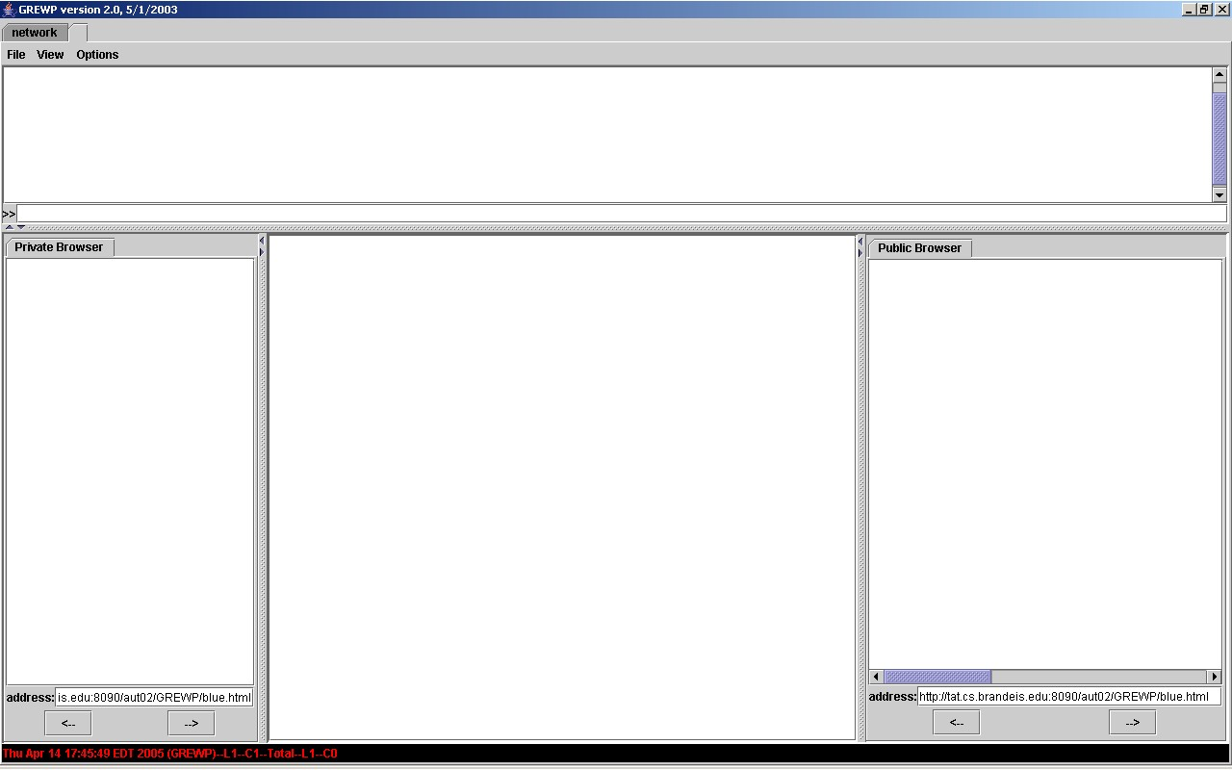
CS111 Experiment
Create a presentation of a world country and its culture.
GREWP tool provides
users with:
  a shared workspace online,
  chat to communicate,
  public and private browsers
  Generates transcripts for replay

Slide 9
Observing the users
Where was the study performed:
  Controlled environment
    We had everything set up before participants arrived
    Tested the software
    etc.
Data collection:
  Note taking: Important issues noted on paper and coordinated with transcripts later.
  Replayed transcripts that the tool generated.

Slide 10
Analyzing the data
Coordinated notes with transcripts
Replayed the transcripts
  Qualitative data (Categorization)
    Looking for incidents or patterns.
    How was a certain task completed?
    How did the users use a certain component in the system?
    One user frequently got stuck in the HTML coding. Why is that?
    Analyzing the discourse (Alex Feinman)

Slide 11
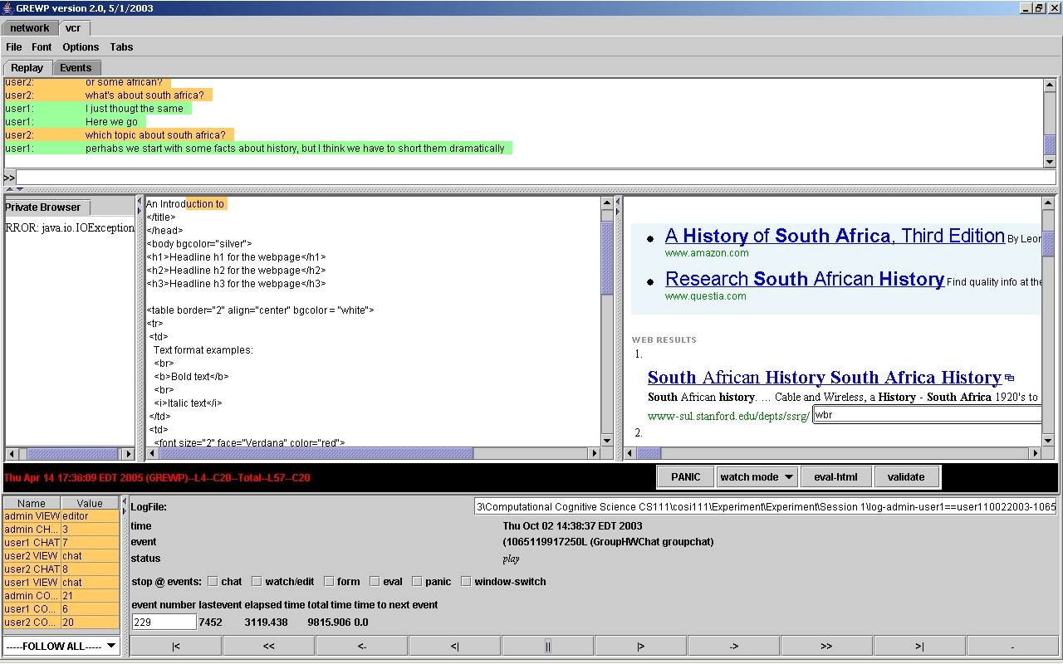
Analyzing data

Slide 12
Redesign
user2: look where I'm in the screen
user2: title is only in the head
user2: not in the normal text
---------
user2: look how I to a table
user2: you only put title only in the head
Proposal 1:
Automatically add reference to a line in the code window to the chat.
Help users stay coordinated

Slide 13
Redesign
user2: how is the work?
user2: how far is your table??
---------
user1: where are you now?
user1: are you finished with the food?
Proposal 2:
Provide a way to write down a plan and review or modify it visually.
Helps users be aware of each others work.
Automatic update of the plan as work progresses.

